Slide 1

Laptop Price Prediction

Slide 2

Contents
Problem Statement
Tools (Libraries) used
Raw Data & Cleaned Data
EDA(Exploratory Data Analysis)
Building the Model
Observations
Challenges
Conclusion

Slide 3
Problem statement
Elon Musk has started his own laptop company (Tesla Laptop) in India. He wants to give tough fights to big companies like Apple, Alienware, HP etc.
Musk wants to find out some relation between features of a Laptop(eg:- RAM, OS, etc) and its
selling price.
The goal of the project is to predict the price of laptops based on various features. The problem is framed as a regression task, where the input features include Brand, ProcessorName,Processor,RAM,SSD,Generation,Operating System,Display Size,Warranty,Rating and the output is the predicted price.

Slide 4






Tools (Libraries) Used
Numpy
Pandas
RegEx
Matplotlib
Seaborn
Pickle
Scikit-Learn

Slide 5
MACHINE LEARNING PROJECT LIFECYCLE
Business Understanding
Data Collection
Data Cleaning
Data Analysis
Data Visualization
Preprocessing
Model Building
Model Evaluation
Model Deployment

Slide 6
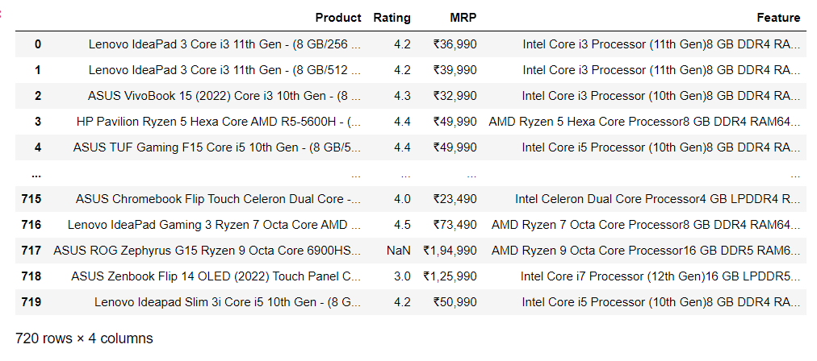
Raw Data

Slide 7
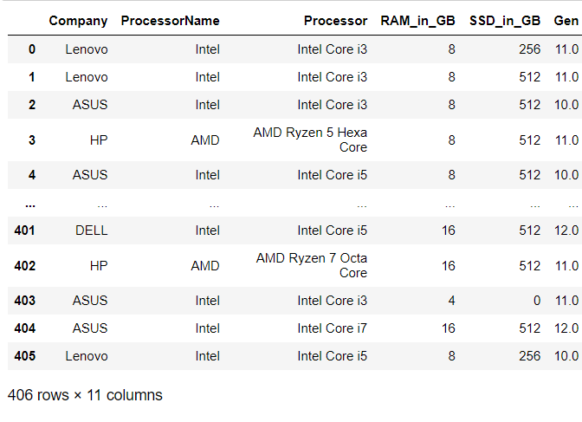
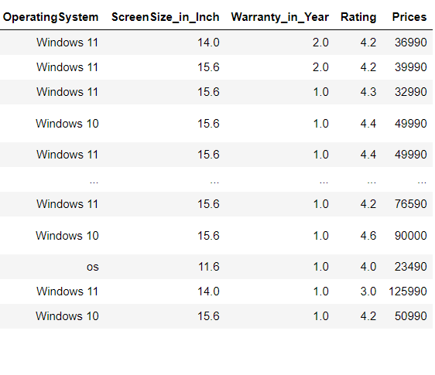
Cleaned Data

Slide 8
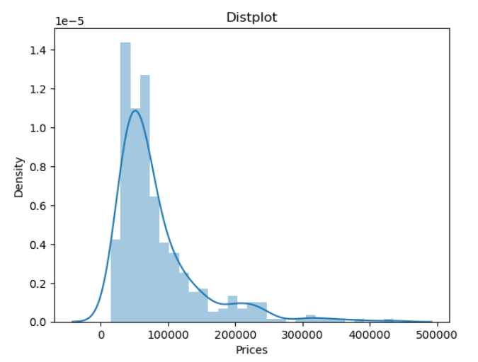
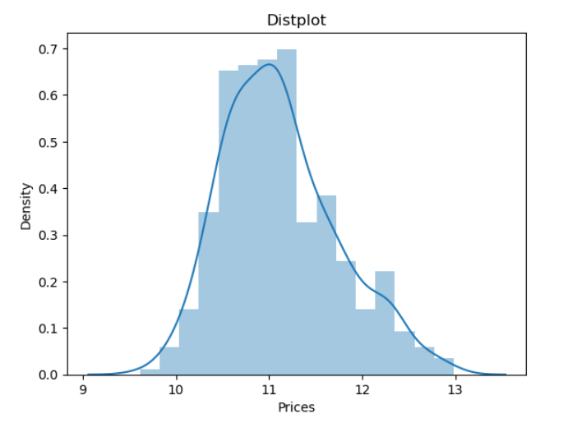
Visualization
Price Column without using log
Price Column with using log

Slide 9
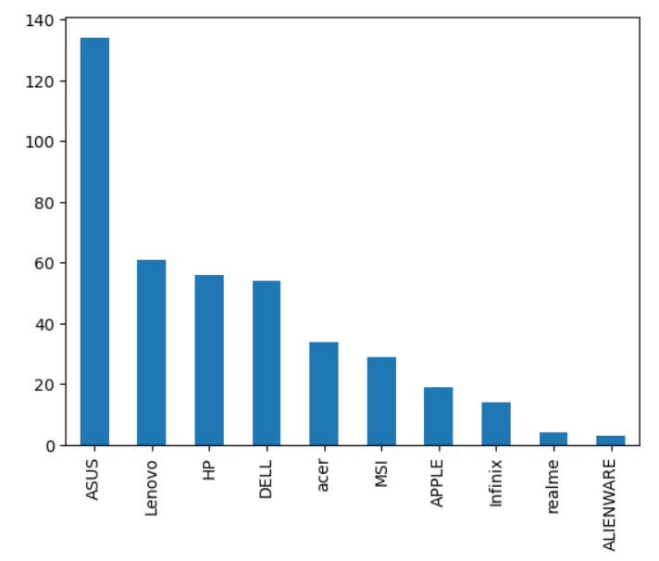
Counting Laptop Brand
Barplot
In this Barplot ,ASUS Laptop having highest number of Laptops in Datasets

Slide 10
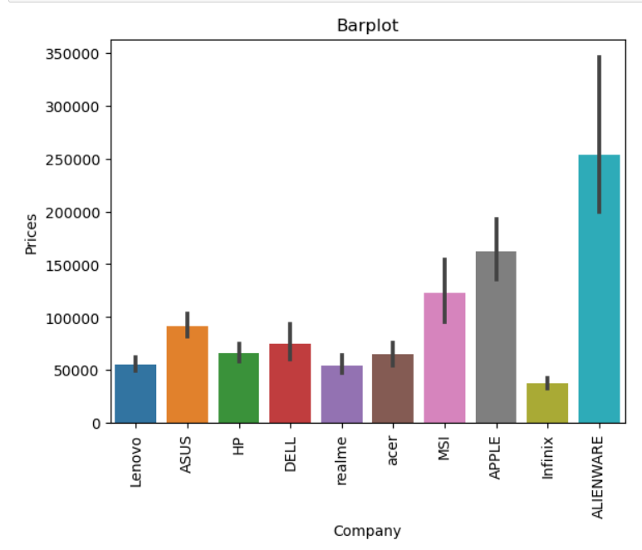
Brand wise Price Analysis
Barplot
In this Barplot, ALIENWARE Laptop is having highest Price of Laptops in Datasets

Slide 11
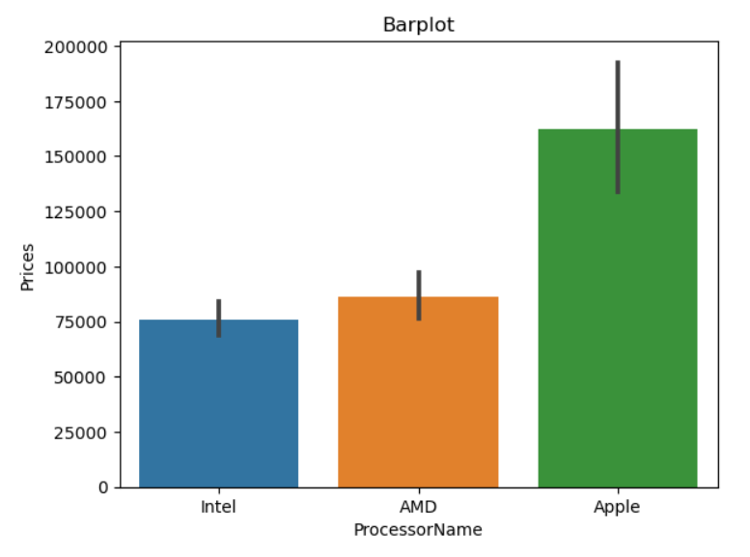
Processor Name wise Price Analysis:
In this Barplot, Apple Processor having highest Price of Laptops in Datasets

Slide 12
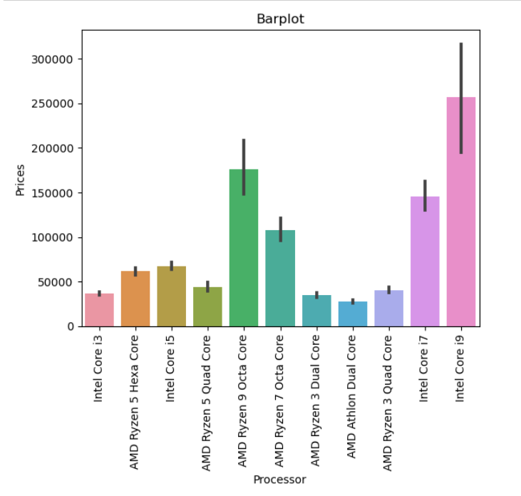
Processor wise Price Analysis:
In this Barplot, Intel Core i9 Processor is having highest Price in Datasets

Slide 13
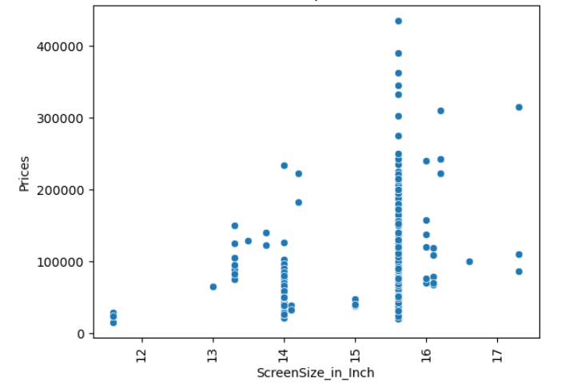
Display Size wise Price Analysis:
In this Scatterplot, Screen_Size between 15-16 inch laptop having highest Price in Datasets

Slide 14
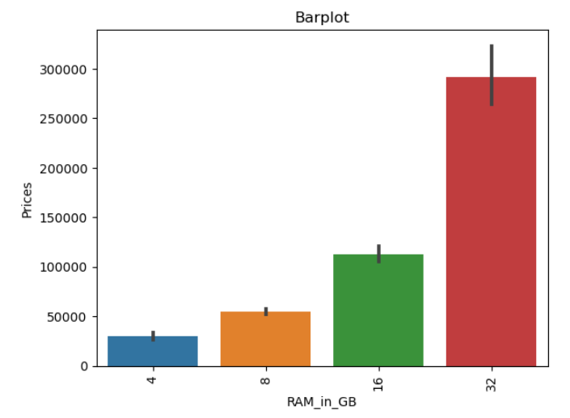
RAM wise Price Analysis:
In this Barplot, 32 GB RAM laptop having highest Price in Datasets

Slide 15
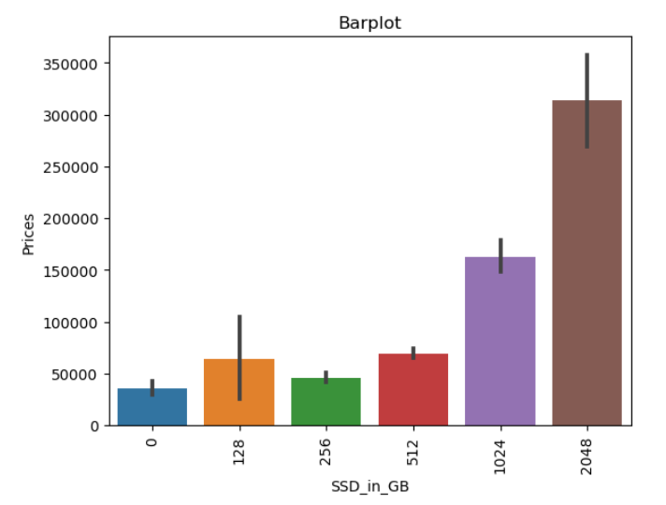
SSD wise Price Analysis:
In this Barplot, 2048 GB SSD laptop is having highest Price in Datasets

Slide 16
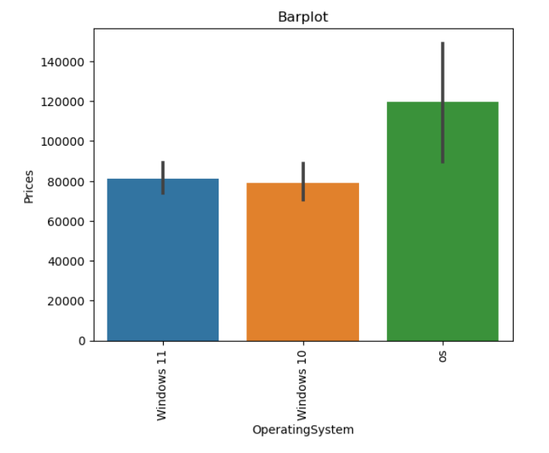
Operating System wise Price Analysis:
In this Barplot, Apple OS laptop having highest Price in Datasets

Slide 17
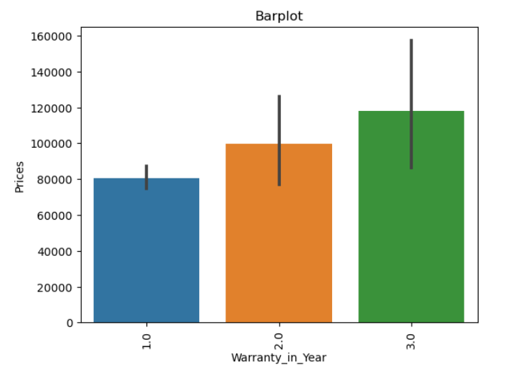
Warranty wise Price Analysis:
In this Barplot, Warranty contain 3 years is having highest Price of laptop in Datasets

Slide 18
PREPROCESSING
Standardized numerical features to bring them to a similar scale
Convert categorical variables into numerical format using techniques like one-hot encoding.
Split dataset into training, and test sets. This helps assess the model's performance and prevent overfitting.
Target Variable is Price and separate this variable from others
Split dataset into 75 and 25 ratio

Slide 19
Model Building and Hyper Parameter Tuning
Decision Tree Algorithm
Random Forest Algorithm
K-Nearest Neighbors Algorithm
AdaBoost Algorithm
Linear Regression Algorithm
Extra Tree
GBDT
XGBOOST
I have used Grid search cv for hyper parameter tuning purpose

Slide 20
Model Evaluation
In this Evaluation part calculate r2_score, mean_absolute_error, mean_squared_error, mean_absolute_percentage_error and Adj_score for each and every Algorithm
Comparing which Algorithm’s score is high
After comparing all Linear Regression is best Algorithm in term of r2_score

Slide 21
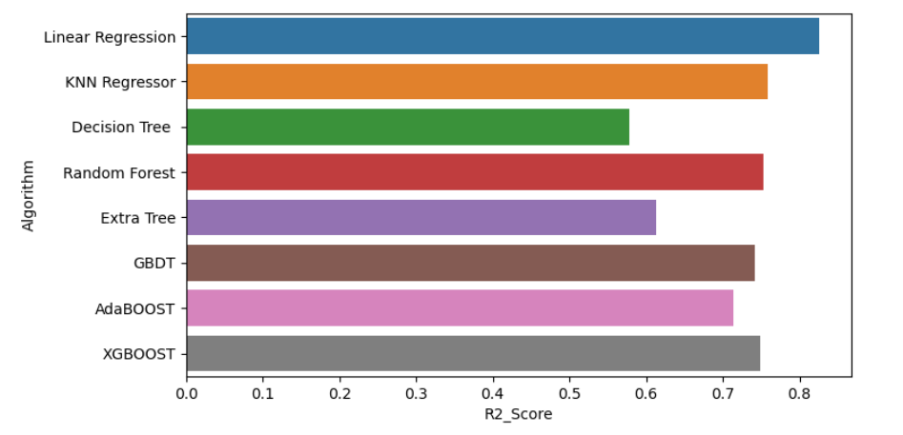
R2 Score score of Different Algorithm

Slide 22
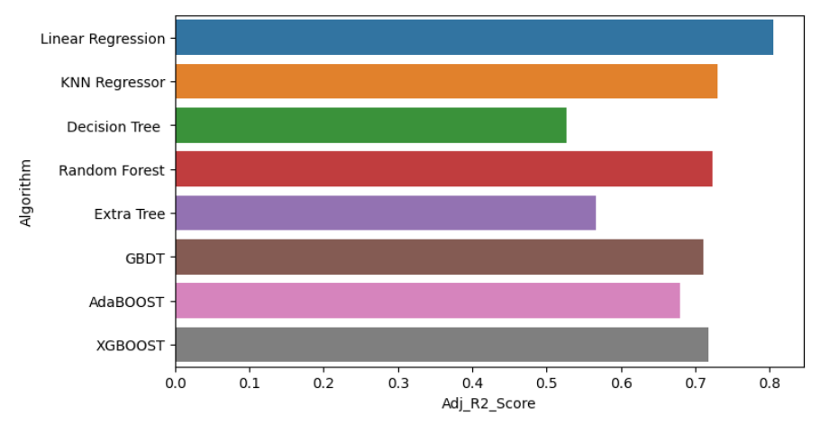
Adj R2 Score score of Different Algorithm

Slide 23
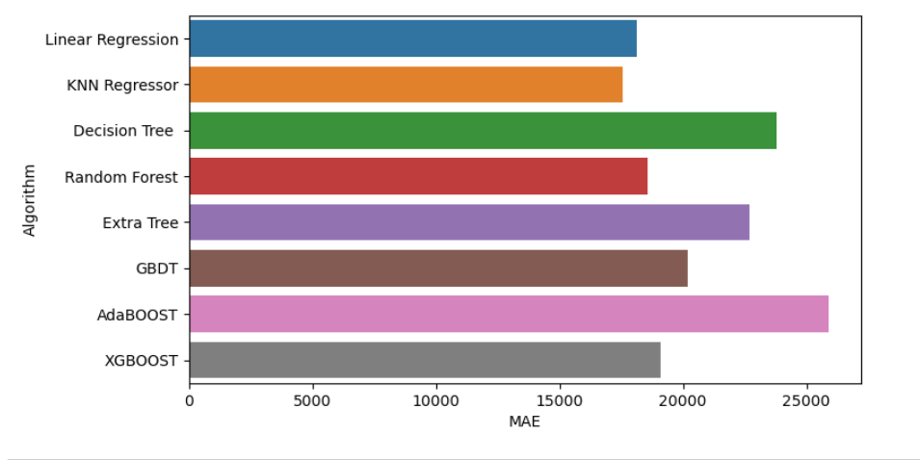
Mean Absolute Error of Different Algorithm

Slide 24
Conclusion
from the above model it has been seen that Linear Regression achieve highest R2 Score with 82.6 %.

Slide 25
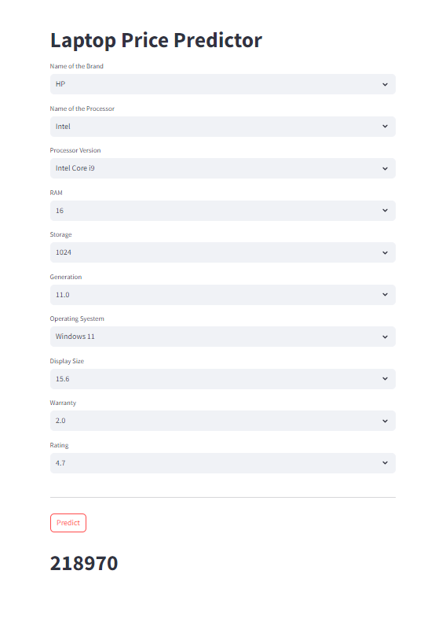
Streamlit Interface

Slide 26


Slide 27


